Slide 1
Chapter 3
Culture and Business

Slide 2
What Is Culture ?
Culture is the beliefs, values, mind-sets, and practices of a specific group of people.
It includes the behavior pattern and norms of a specific group—the rules, the assumptions, the perceptions, and the logic and reasoning that are specific to a group.
Culture is really the collective programming of our minds from birth. It’s this collective programming that distinguishes one group of people from another.
Cultural awareness most commonly refers to having an understanding of another culture’s values and perspective

Slide 3
What Is Culture?
When trying to understand how cultures evolve, we look at the factors that help determine cultures and their values.
In general, a value is defined as something that we prefer over something else—whether it’s a behavior or a tangible item.
Values are usually acquired early in life and are usually non rational. Our values are the key building blocks of our cultural orientation.

Slide 4
What Kinds of Culture Are There?
When we say cultural, we don’t always just mean people from different countries.
Cultures exist in all types of groups. There are even subcultures within a country or target ethnic group.
Each person belongs to several kinds of cultures: national, sub cultural (regional, gender, ethnic, religious, generational, and socioeconomic), and group or workplace (corporate culture).

Slide 5
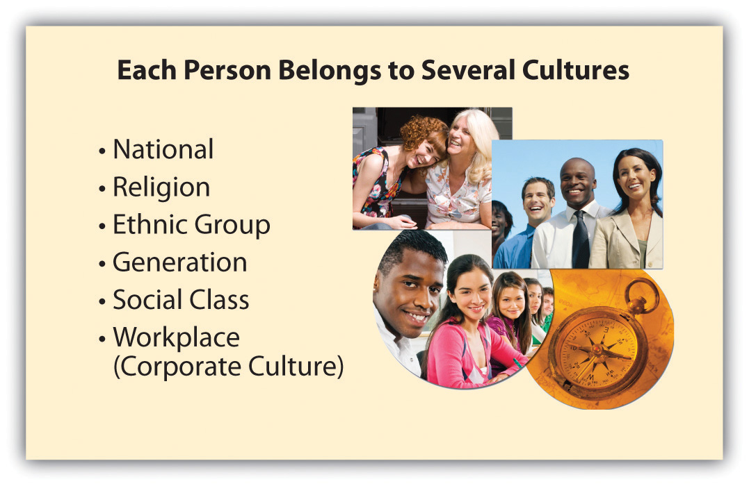
What Kinds of Culture Are There?

Slide 6
Geert Hofstede, Edward T. Hall
There are two key methods used to describe and analyze cultures.
Geert Hofstede , focuses on five key dimensions that interpret behaviors, values, and attitudes: power distance, individualism, masculinity, uncertainty avoidance, and long-term orientation.
Edward T. Hall , focuses on three main categories for how communications and interactions between cultures differ: high-context versus low-context communications, space, and attitudes toward time.

Slide 7
Power distance
refers to how openly a society or culture accepts or does not accept differences between people, as in hierarchies in the workplace, in politics, and so on.
For example, high power distance cultures openly accept that a boss is “higher” and as such deserves a more formal respect and authority.
Examples of these cultures include Japan, Mexico, and the Philippines. In Japan or Mexico, the senior person is almost a father figure and is automatically given respect and usually loyalty without questions

Slide 8
Individualism
It refers to people’s tendency to take care of themselves and their immediate circle of family and friends, perhaps at the expense of the overall society.
In individualistic cultures, what counts most is self-realization. Initiating alone, sweating alone, achieving alone—not necessarily collective efforts—are what win applause.
In individualistic cultures, competition is the fuel of success.

Slide 9
masculinity
It’s about how a society views traits that are considered masculine or feminine
In masculine-oriented cultures, gender roles are usually crisply defined. Men tend to be more focused on performance, ambition, and material success.
They cut tough and independent personas, while women cultivate modesty and quality of life.
Cultures in Japan and Latin American are examples of masculine-oriented cultures.

Slide 10
uncertainty avoidance
This refers to how much uncertainty a society or culture is willing to accept.
It can also be considered an indication of the risk propensity of people from a specific culture.
People who have high uncertainty avoidance generally tend to appreciate very clear instructions
At the office, sharply defined rules and rituals are used to get tasks completed.

Slide 11
uncertainty avoidance
Stability and what is known are preferred to instability and the unknown.
Company cultures in these countries may show a preference for low-risk decisions, and employees in these companies are less willing to exhibit aggressiveness.
In countries with low uncertainty avoidance, people are more willing to take on risks, companies may appear less formal and structured, and “thinking outside the box” is valued.
Examples of these cultures are Denmark, Singapore, Australia

Slide 12
long-term orientation
refers to whether a culture has a long-term or short-term orientation the effort to understand the difference in thinking between the East and the West
The long-term orientation values persistence, perseverance, thriftiness, and having a sense of shame. These are evident in traditional Eastern cultures.
Based on these values, it’s easy to see why a Japanese CEO is likely to apologize or take the blame for a faulty product or process.

Slide 13
long-term orientation
The short-term orientation values tradition only to the extent of fulfilling social obligations or providing gifts or favors.
These cultures are more likely to be focused on the immediate or short-term impact of an issue.
Not surprisingly, the United Kingdom and the United States rank low on the long-term orientation.

Slide 14
other determinants of culture.
In addition to the main analytical methods for comparing and contrasting cultures, there are a number of other determinants of culture.
These determinants include manners, mind-sets, values, rituals, religious beliefs, laws, arts, ideas, customs, beliefs, ceremonies, social institutions, myths and legends, language, individual identity, and behaviors.
Language includes both verbal and physical languages.

Slide 15
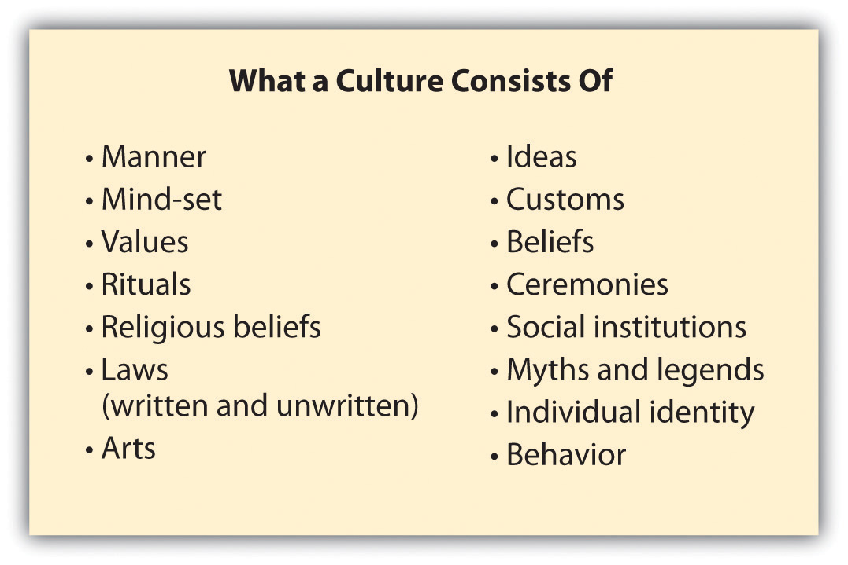
What Else Determines a Culture?

Slide 16
Understanding How Culture Impacts Local Business Practices
Professionals often err when they think that in today’s shrinking world, cultural differences no longer pertain.
People mistakenly assume that others think alike just because they dress alike and even sound similar in their choice of words in a business setting.
Even in today’s global world, there are wide cultural differences and these differences influence how people do business.

Slide 17
Spotlight on Cultures and Entrepreneurship
Culture impacts many elements of business, including the following:
  the pace of business
  business protocol—how to physically and verbally meet and interact
  decision making and negotiating
  managing employees and projects
  propensity for risk taking
  marketing, sales, and distribution

Slide 18
Impact of Culture on Business
When you’re dealing with people from another culture, you may find that their business practices and communication and management styles are different from what you are accustomed to.
Understanding the culture of the people you are dealing with is important to successful business interactions as well as to accomplishing business objectives.

Slide 19
Impact of Culture on Business
For example, you’ll need to understand the following:
  how people communicate
  how culture impacts how people view time and deadlines
  how people are likely to ask questions or highlight problems
  how people respond to management and authority
  how people perceive verbal and physical communications
  how people make decisions

Slide 20
global business ethics
Culture impacts how local values influence the concept of global business ethics.
Each professional is influenced by the values, social programming, and experiences he or she has absorbed since childhood.
These collective factors impact how a person perceives an issue and the related correct or incorrect behavior.

Slide 21
global business ethics
For some cultures, the evolution of international business and culture sometimes creates a conflict, such as what is seen in gift-giving practices or views on women in the workplace.
Ethics impacts global business in the areas of management, corruption, and corporate social responsibility.

Slide 22
Conducting Business and Negotiating
One of the most important cultural factors in many countries is the emphasis on networking or relationships.
Even if you have been invited to bid on a contract, you are still trying to sell your company and yourself
Make sure you understand how your overseas associates think about time and deadlines.

Slide 23
Conducting Business and Negotiating
You need to understand the predominant corporate culture of the country you are dealing with—particularly when dealing with vendors and external partners.
Understand how you can build trust with potential partners.
How do people communicate?

Slide 24
Conducting Business and Negotiating
Focus on communications of all types and learn to find ways around cultural obstacles.
There are no clear playbooks for operating in every culture around the world.
Make sure in any interaction that you have a decision maker on the other end.
When negotiating with people from a different culture, try to understand your counterpart’s position and objectives.

Slide 25
Conducting Business and Negotiating
Even in today’s wired world, don’t assume that everyone in every country is as reliant on the Internet and e-mail as you are.
As with any business transaction, use legal documents to document relationships and expectations.

